Slide 1

Velalar College of Engineering and Technology
18ITL81- MAIN PROJECT
CLASSIFICATION OF HUNTINGTON’S DISEASE AND ITS STAGES USING MACHINE LEARNING
Presented by,
MULLAIVENTHAN N (19ITR065)
SHANMUGAAPRIYAA S (19ITR096)
SHARUKKHAN R I (19ITR098)
VINITHA S (19ITR122)
Under the Guidance of
Ms. PREMA P, M.E.,

Slide 2
ABSTRACT
Velalar College of Engineering and Technology
Huntington’s Disease (HD) is a progressive neurodegenerative disorder caused by a genetic mutation on chromosome 4.
It is characterized by the gradual degeneration of nerve cells in the brain, leading to movement disorders, cognitive decline, and psychiatric symptoms.
Machine learning is to classify the HD and its stages by analyzing patterns in patient data such as genetic information, imaging scans, and clinical indication.
Convolution Neural Network (CNN) is a widely used algorithm for predicting the image with high accuracy.
So far there are no techniques to diagnose Huntington’s disease. This one could be the first technique with a high accuracy rate.

Slide 3
Velalar College of Engineering and Technology
PROBLEM STATEMENT
The problem statement for classifying Huntington's disease (HD) and its stages using machine learning could be formulated as follows:
Given the dataset of a patient including the genetic information, and imaging scans, develop a machine learning model that can accurately classify HD patients into one of the three stages of the disease (early, middle, or late) and predict the progression of the disease over time.
The model should take into account the complex and multidimensional nature of HD and should be able to handle missing or incomplete data.
The model should be validated using a separate test dataset for high accuracy and precision.

Slide 4
Velalar College of Engineering and Technology
LITERATURE SURVEY
ARTIFICIAL NEURAL NETWORKS (ANN)
Shubham Bind, Arvind Kumar Tiwari, and Anil Kumar Sahani, “A Survey of Machine Learning Based Approaches for Parkinson Disease Prediction,” (IJCSIT) International Journal of Computer Science and Information Technologies, Vol. 6 (2), 2015, 1648-1655.
Proposed Artificial Neural Network algorithm computes values from input and is capable of pattern recognition.
Artificial neural networks are generally presented as systems of interconnected "neurons" which can compute values from inputs/output and are capable of machine learning as well as pattern recognition.

Slide 5
Velalar College of Engineering and Technology
LITERATURE SURVEY
SUPPORT VECTOR MACHINE (SVM)
Diogo Braga, Ana M. Madureira, Luis Coelho, and Reuel Ajith, “Automatic detection of Parkinson’s disease based on acoustic analysis of speech,” Interdisciplinary Studies Research Center (ISRC), School of Engineering from Polytechnic of Porto (ISEP/IPP), Porto, Portugal, Volume 77, January 2019.
The results reveal the potential of using Random Forest (RF) or Support Vector Machine (SVM)
Once tuned, these algorithms provide a reliable computational method for estimating the presence of PD with very high accuracy.
It does not execute very well when the data set has more sound i.e. target classes are overlapping.

Slide 6
Velalar College of Engineering and Technology
LITERATURE SURVEY
BACK PROPAGATION ALGORITHM
Freddie Åström, and RasitKoker, “A parallel neural network approach to the prediction of Parkinson’s Disease,” Computer Vision Laboratory, Department of Electrical Engineering, Linköping University, SE-58183 Linköping, Sweden, Volume 38, Issues 10, September 15, 2019.
Backpropagation, or backward propagation of errors, is an algorithm that is designed to test for errors working back from output nodes to input nodes.
It is an important mathematical tool for improving the accuracy of predictions in data mining and machine learning.
The disadvantage of using a backpropagation algorithm is it prefers a matrix-based approach over a mini-batch approach.

Slide 7
Velalar College of Engineering and Technology
LITERATURE SURVEY
NAIVE BAYES ALGORITHM
Arti Rana, Ankur Dumka, Rajesh Singh, Manoj Kumar Panda, Neeraj Priyadarshi, and Bhekisipho Twala, “Imperative Role of Machine Learning Algorithm for Detection of Parkinson’s Disease: Review, Challenges, and Recommendations,” Department of Computer Science and Engineering, Women Institute of Technology, Uttarakhand Technical University (UTU), Dehradun 248007, Uttarakhand, India, 19 August 2022.
Naive Bayes assumes that all predictors (or features) are independent, which rarely happens in real life.
This algorithm faces the 'zero-frequency problem where it assigns zero probability to a categorical variable whose category in the test data set wasn't available in the training dataset.

Slide 8
Velalar College of Engineering and Technology
LITERATURE SURVEY
XG BOOST ALGORITHM
Raksha Sharma, “Detecting Parkinson’s disease using machine learning,” Novateur Publications, International Journal of Innovations in Engineering Research and Technology [IJIERT], Volume 8, Issue 7, July 2021.
XG Boost- is an implementation of gradient-boosted decision trees designed for speed and performance that is dominative competitive machine learning.
XGBoost provides a wrapper class to allow models to be treated like classifiers or regressors in the scikit-learn framework.
This means we can use the full sci-kit-learn library with XGBoost models.

Slide 9
EXISTING SYSTEM
Velalar College of Engineering and Technology
As the prevalence of digital health technology and the subsequent collection of large amounts of complex health data increases, machine learning (ML) methods provide epidemiologists with a robust way to analyze and interpret relevant patterns.
The existing system works with the help of the Decision Tree algorithm which is used for the classification of sensor-based features allowed for the discrimination of Parkinson’s Disease(PD).
The early and advanced stages of PD provide an accuracy of 73.7%.

Slide 10
DRAWBACKS
Velalar College of Engineering and Technology
The error made in the beginning is significant, and if it's not remedied, it causes chaos.
Decision trees are more likely to overfit the data since they can split on many different combinations of features.
Any inaccuracy in a variable would have a significant impact on the result.
The result from data interpretation is of Low Quality.

Slide 11
PROPOSED SYSTEM
Velalar College of Engineering and Technology
The genetic mutation on chromosome 4 causes Huntington's disease (HD), a progressive neurological condition known as HD.
HD patients can be categorized based on the disease stage and predicted using machine learning approaches.
CNN sets in a frame, which is a type of deep-learning model used for image recognition and classification.
Additionally, clinical data and genetic information can be analyzed using machine learning algorithms to forecast HD progression and identify patients at risk for the condition.

Slide 12
ADVANTAGES
Velalar College of Engineering and Technology
The main advantage is using CNN Algorithm which is used to predict the highest accuracy images.
HD can be detected through genetic testing which can help to identify the disease before the symptoms appear.
Early detection helps slow down the progression of the disease.
Treatment of HD can help improve the quality of life for those affected by the disease

Slide 13
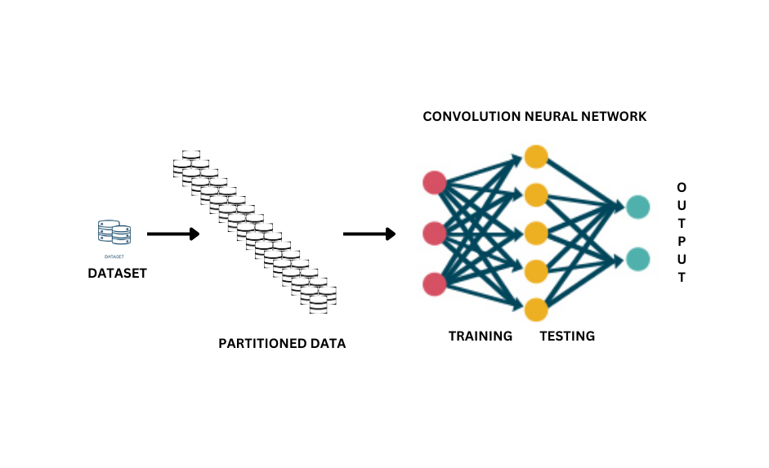
PROPOSED ARCHITECTURE DIAGRAM
Velalar College of Engineering and Technology

Slide 14
MODULES
Velalar College of Engineering and Technology
Tutoring the dataset with the help of the CNN algorithm
Carrying out Trials on input models
Evaluation for the diagnosis is made.

